Slide 1
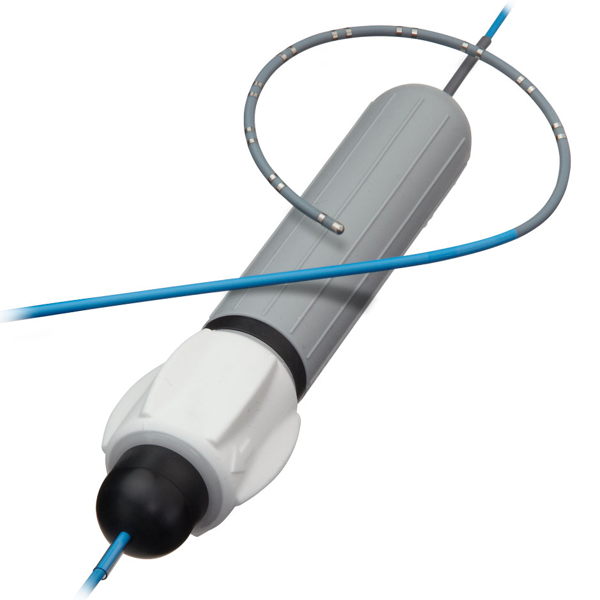
Team 28 Electronically Steerable Catheter
Zane Johnson, Tanner Karbonik, Erin McFadden,
Michael Pass, Matthew Situmeang

Slide 2

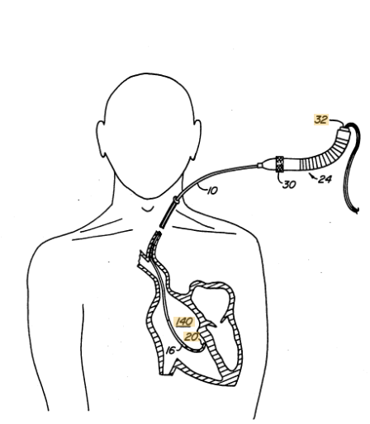
Motivation/Background
- Atrial fibrillation affects
nearly 2 million people yearly
- Minimally invasive surgeries
are increasingly more common
and require state of the art devices
Notes:
And heart surgeries are very prevalent as well.
The current solution for minimally invasive surgeries is using a steerable catheter. *Next slide*

Slide 3
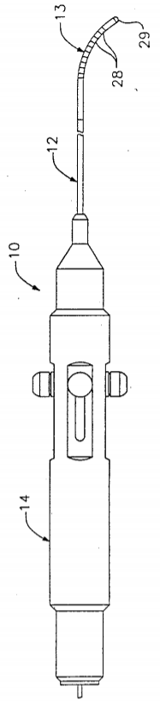
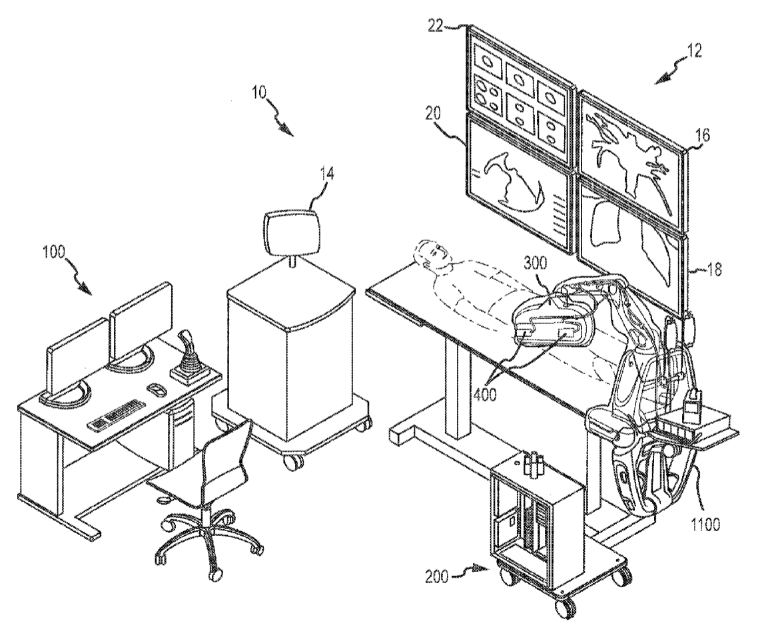
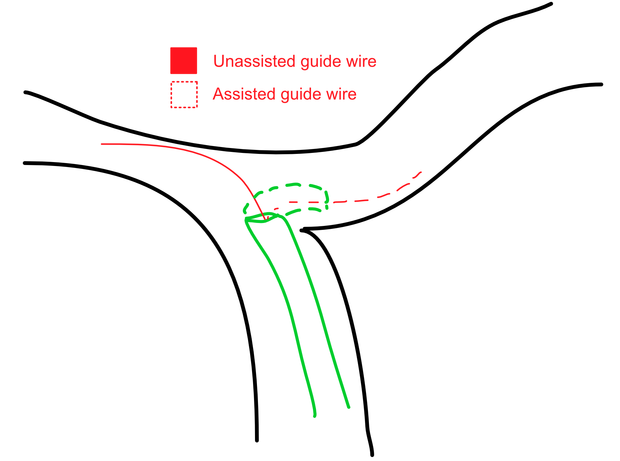
Research

Slide 4
A way to improve the usability and actuation of steerable catheters controlled by surgeons to increase surgical accuracy and decrease procedural time.
Notes:
Our needs statement

Slide 5






Functional Requirements
AFFORDABLE
ELECTRONICALLY CONTROLLED
ONE-HANDED USE
PRECISE ANGLES
WATERPROOF
STERILE

Slide 6
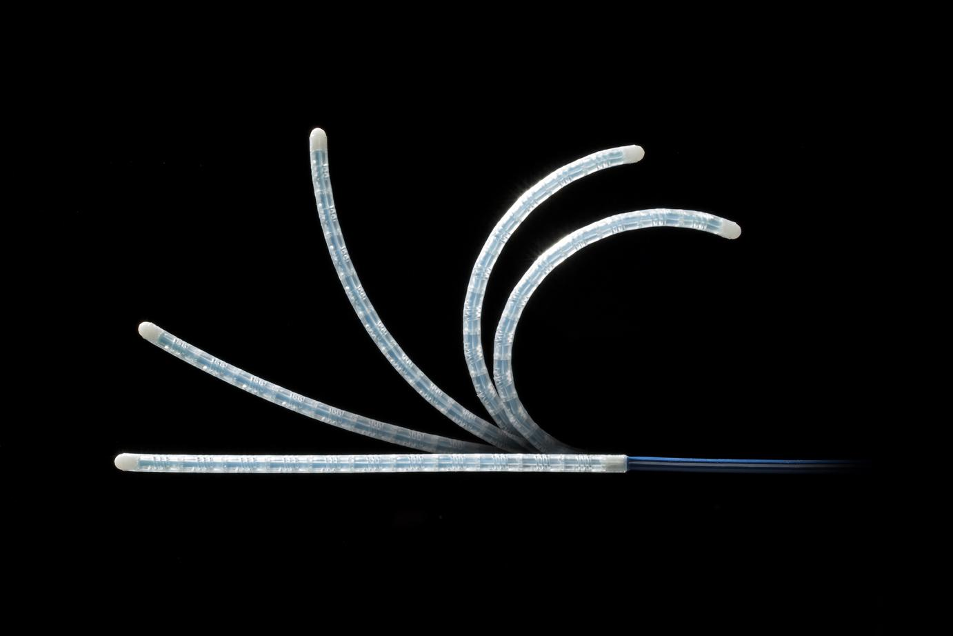
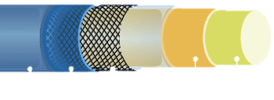
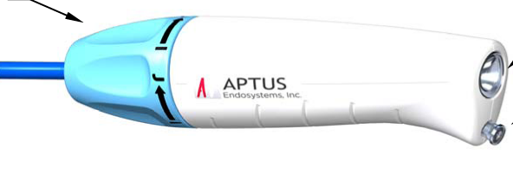
Key Modules:
Electronic Actuation (MCM) | Handle Design/User Interface | Materials/ Catheter Design

Slide 7
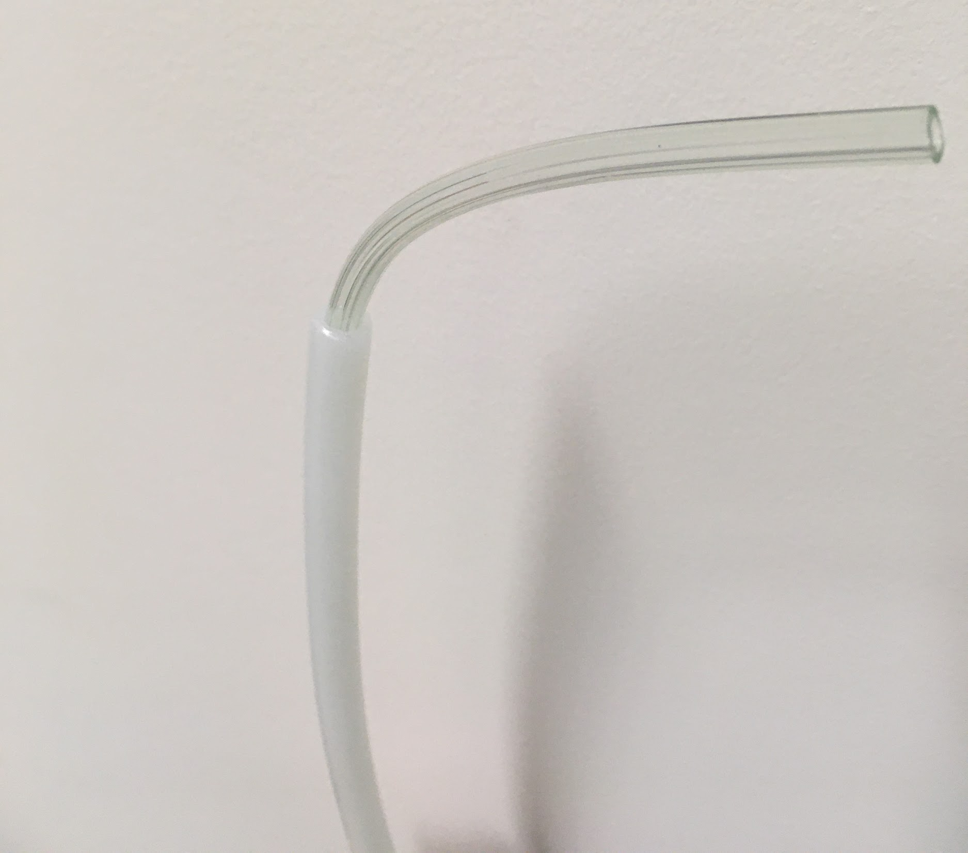
1st Prototype
Flexible inner tubing
Cons
Failed to straighten back to vertical position
Kinked/snaked the tubing
Difficult to steer
Single wire attachment
Stiff outer tubing

Slide 8
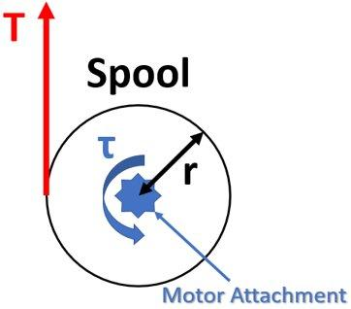
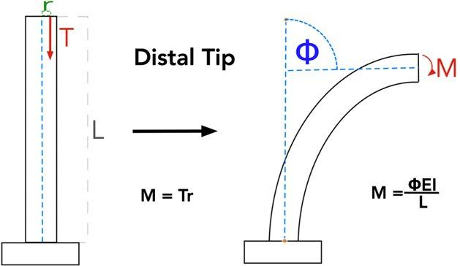
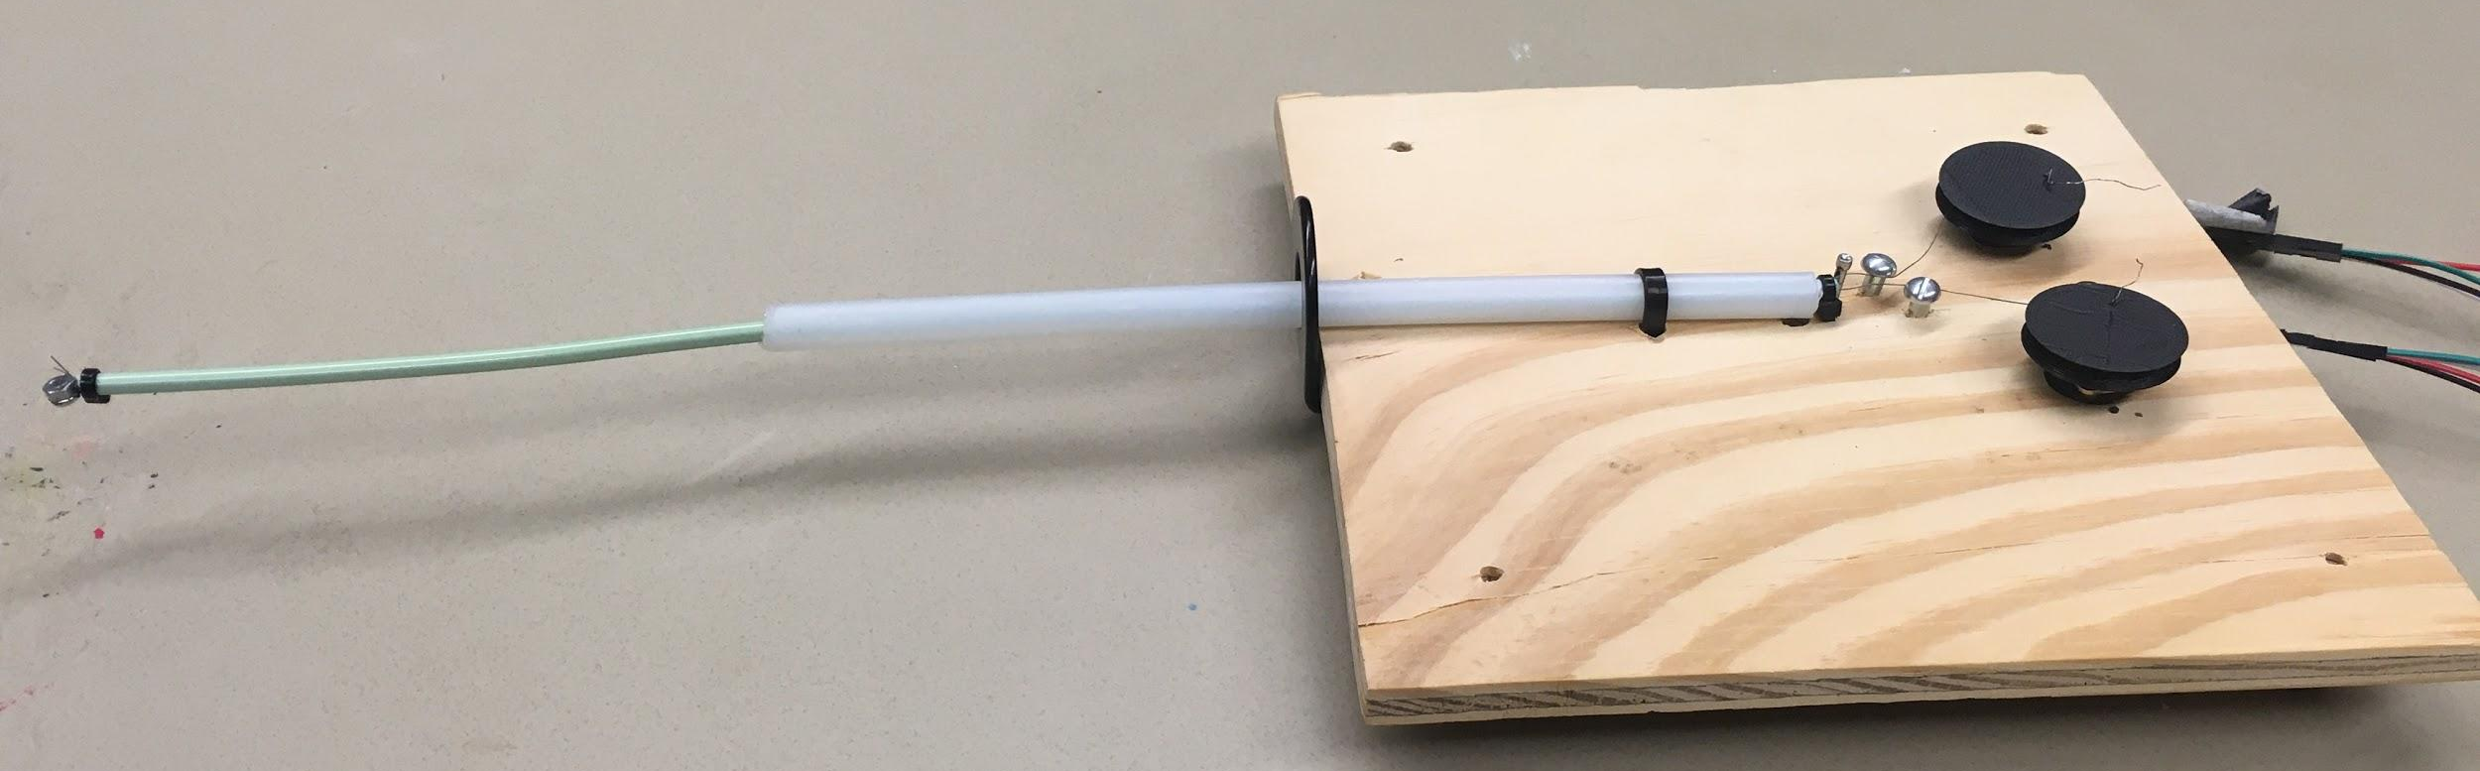
2nd Prototype
Bidirectional actuation
Functional electronics
Learned about
Spool radius
Torque applied
Bending moment
Tension force

Slide 9
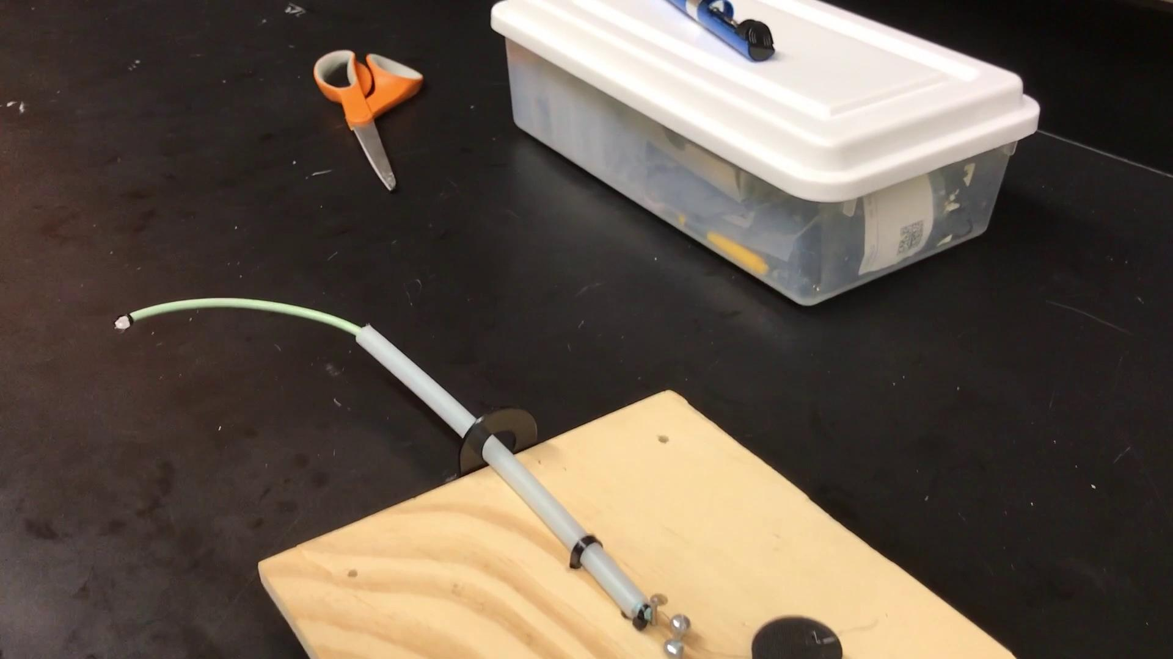

Slide 10
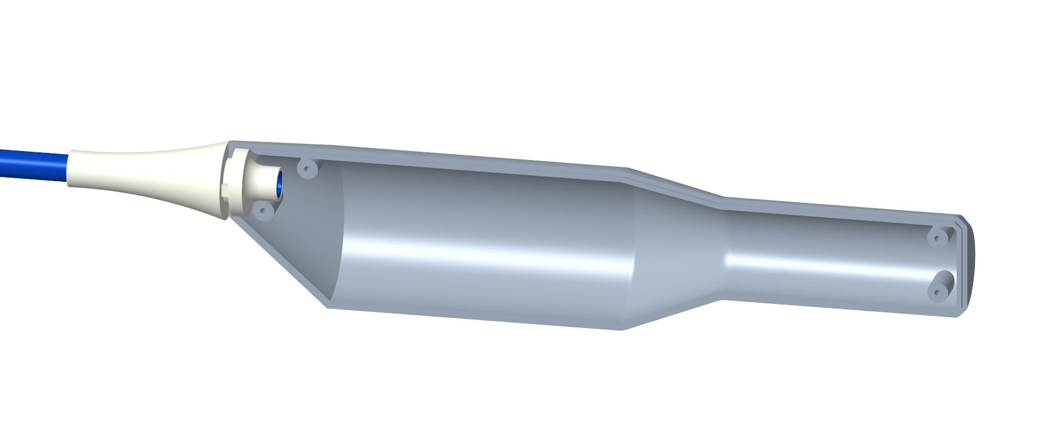
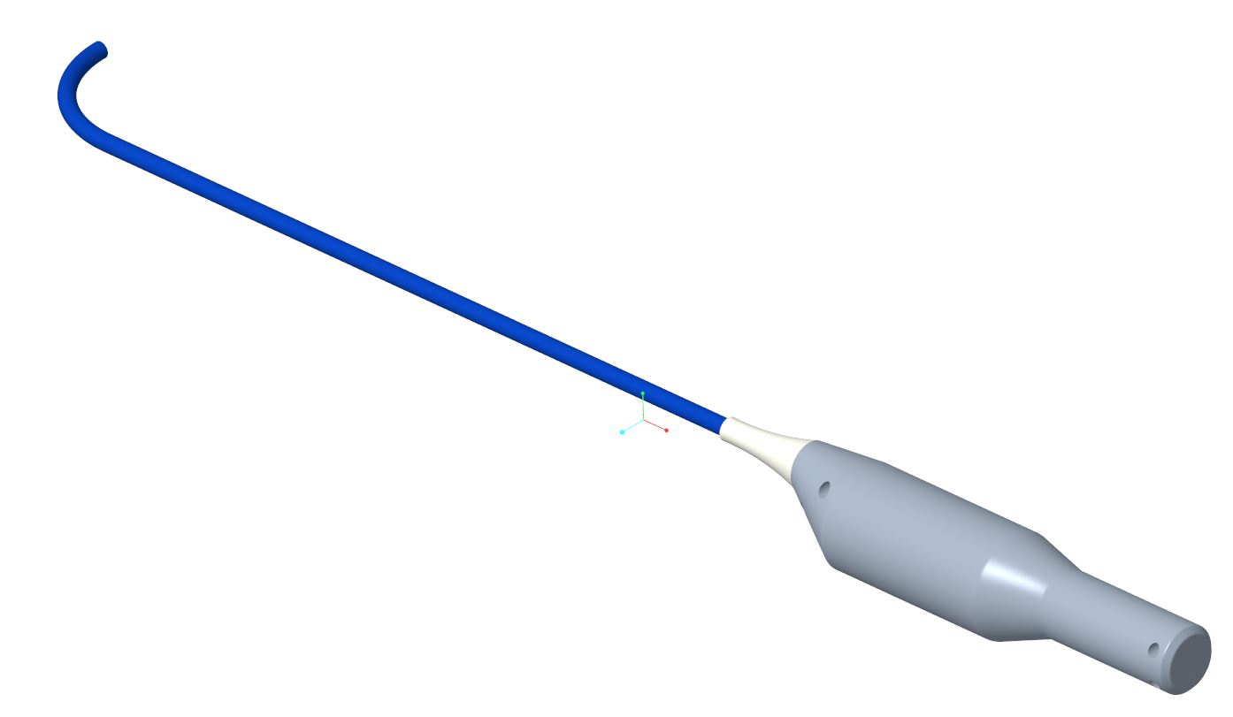
Handle Design/User Interface
“Highlight the rounded edges and the smaller diameter of the handle, ergonomic design”

Slide 11
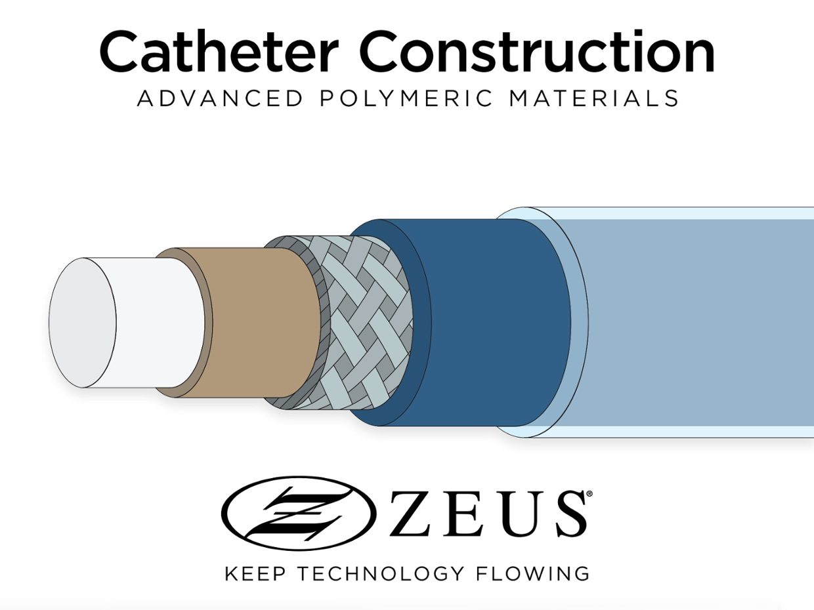
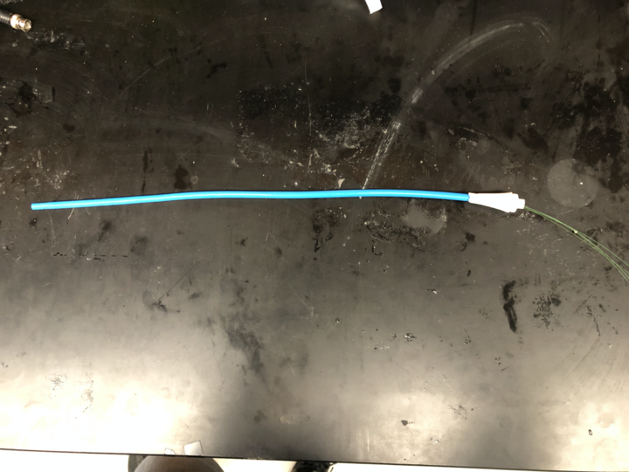
Materials/Catheter Design
Pebax Jacket
Extrusion
PTFE Mandrel
Stainless steel braiding
FEP - Heat Shrink

Slide 12
Future Prototype Questions
How can we fit all the components in the handle?
How can we achieve multiplane actuation?
How can we readout the angle of the tip?
How can we attach the wires and catheter to the handle?
How can we determine the proper materials according to our actuation mechanism?

Slide 13
Functional Requirements
Progress
Affordable
On track
Electronically Controlled
Concept proven
One handed use
Working on handle design
Precise angles
Currently testing
Waterproof
Future consideration
Sterile
Future consideration

Slide 14
 | Updates Presentations |  | Spring Break |  |  |  |  |  | Senior Design Day - 5/1 | Final Report
Week of: | Mar 02 | Mar 09 | Mar 16 | Mar 23 | Mar 30 | Apr 06 | Apr 13 | Apr 20 | Apr 27 | May 04
Get PCBs
Manufacture Prototype Parts (catheter handle, spools, etc.)
Assemble Prototype
Test for Angle Readout Equations
Test and Redesign Prototype
ISO and FDA Standards for Design

